Slide 1
Motiva Ontology: A domain model for motivational assistants in Personal Development Applications
Walkthrough and review

Slide 2
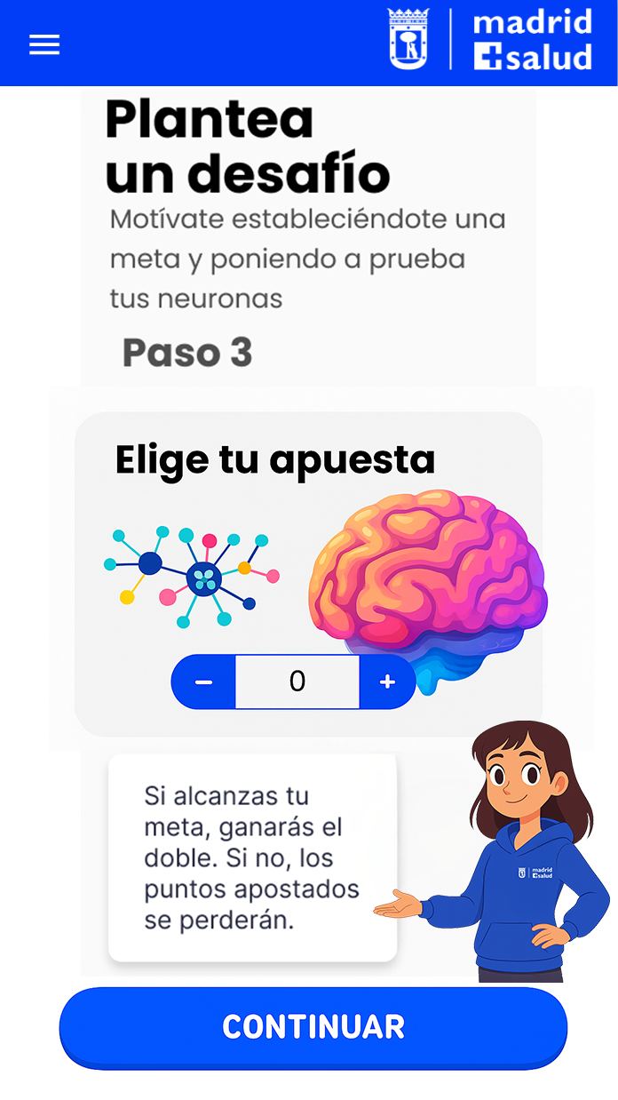

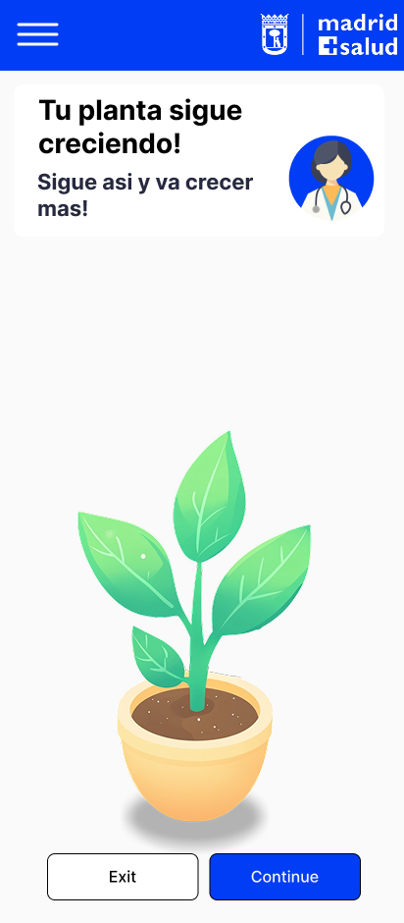
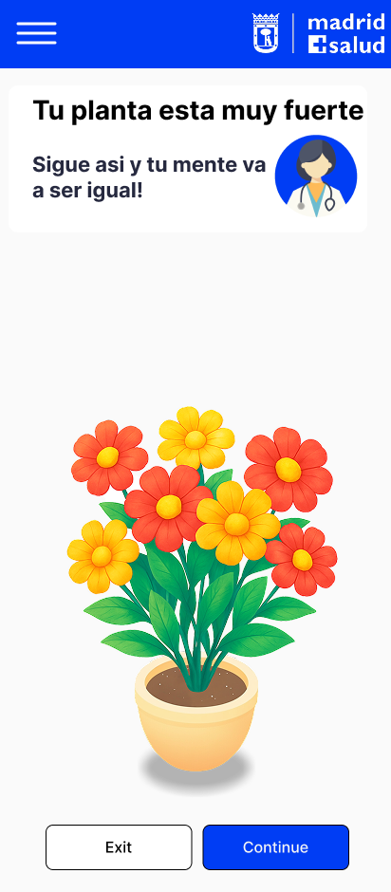
Introduction
What is a Personal Development Application (PA)
Application that supports users in improving habits, skills and well being
Provides interactive lessons or content around a certain personal development domain
Users often lose motivation and discipline over time
What does the Motivational Assistant (MA) do
Helps the user stay engaged and motivated by providing different gamification mechanics
Uses personalized messages and features like progress tracking, challenges and rewards
Keeps a user model containing:
State (dynamic)
Traits (static)

Slide 3
Motivational Assistant Concept
Core Pipeline: measure → decide → deliver
Purpose Maintain engagement and habit formation through adaptive feedback without overloading user.
Guardrails:
Temporal smoothing for consistent adaptation
Provenance ensures continuity with baseline profiles
Deactivate mechanics with low observed usage despite trait fit
Continuous recalibration from recent metrics

Slide 4
Context and Scope
The Motivational Assistant works as a Modular Plugin
The Motivational Assistant (MA) is a standalone codebase/app/module that is separated from the base system
The Personal Development Application (PA) delivers content, lessons, or activities to the user
The MA can be attached to different applications via a plugin-like architecture.
Implementation of the plugin-like architecture differs for different use cases

Slide 5
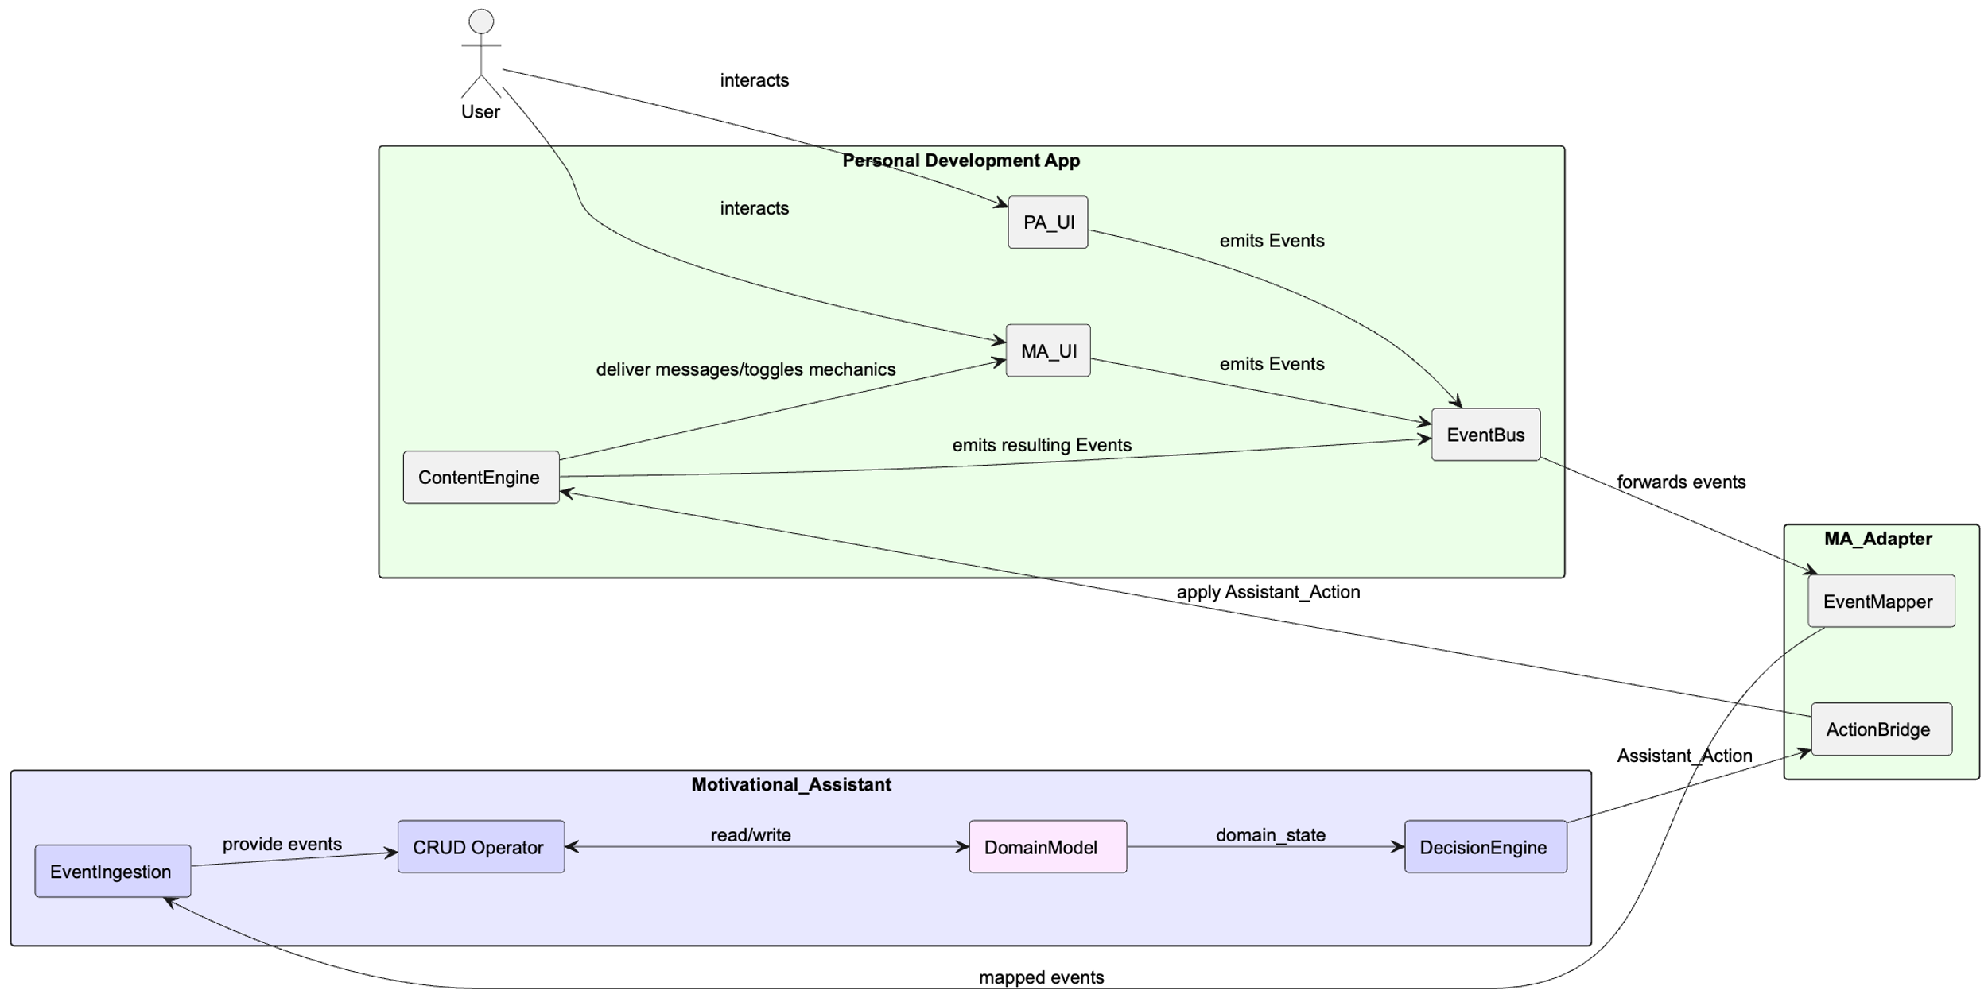
High Level System Architecture
Separate Systems

Slide 6
Problem Statement
We define a domain model for a motivational assistant as an ontology
Reuse existing ontologies
Existing ontologies lack domain generalization and practical use for developers
We provide:
Implementation focused guidelines and vocabulary for developers
Provide vocabulary for designers
Evaluation of an MA to their PA or to evaluate their already existing MA

Slide 7
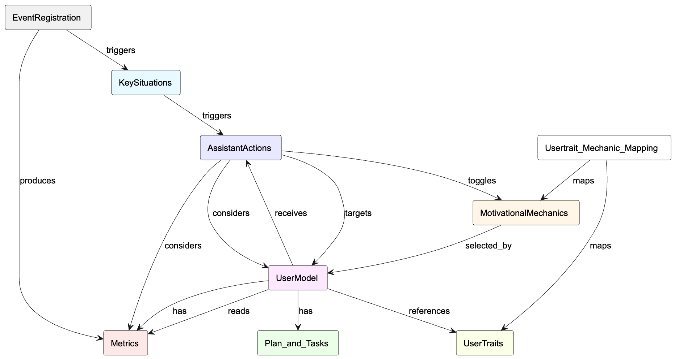
High Level Modular Ontology

Slide 8
Motivation and Research Gap
Problem:
Existing gamification ontologies are too abstract or too domain/ application specific
Developers lack reusable, implementation-oriented models
Need:
Modular, domain-agnostic ontology powering the design of a motivational assistant

Slide 9
Contribution
Modular semantic framework for a generalized motivational assistant in OWL and UML that can be applied in any behavior change and self improvement context
Catalog of 65 mechanics sourced from existing material categorized in 10 groups
Mechanics ranked through a user survey linking player types, Big Five personality traits, and motivational traits to mechanic preferences
To be validated in two applications: MejoraLaMemoria and FrailStop

Slide 10
Current Situation and Motivation
Existing apps: motivation logic deeply embedded → hard to reuse
Desired: motivational assistant as a reusable module.
Vision: any app can integrate motivation logic via an adapter.

Slide 11
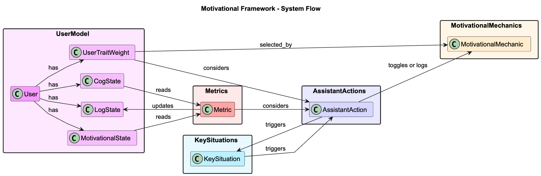
High Level Motivational Assistant Flow

Slide 12
Ontology Overview
Main Modules:
EventRegistration:
Captures user and system actions as timestamped events
KeySituations:
Occur when one or more important events coincide.
AssistantActions:
Delivered prompts that ecourage user action or change in behaviour such as messages, questionnaires, or toggle of mechanics
UserModel:
Stores user traits, states and relates a single user to metrics and plans
Metrics:
Computes measurements from events and usage.
Plan_and_Tasks:
Defines tasks blocks, repetition requirements and planned user progression
MotivationalMechanics:
Catalog of mechanics that influence motivation.
UserTraits:
Describes stable user characteristics and player types.
Main relationships:
triggers: Source causes the target to occur.
reads: Target is queried to inform the source.
considers: Source uses target as an input to decide.
selected_by: Mechanic choice depends on the target weights.
maps: Links two classes and describes the strength of their relationship
toggles: Enables or disables a mechanic or feature.

Slide 13
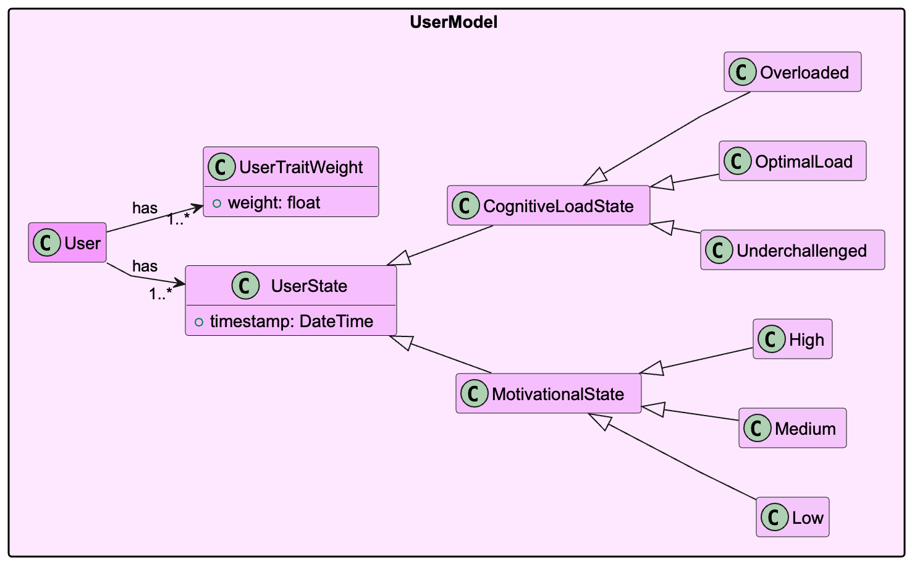
UserModel
Holds Usertraits (Static)
Holds UserState (Dynamic)

Slide 14
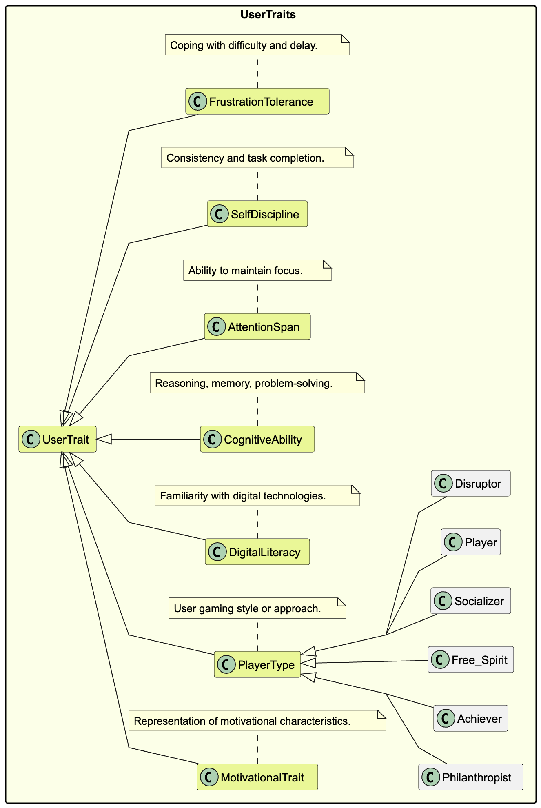
UserTraits and Mapping
Traits:
Hexad player types + cognitive/behavioral traits
UserTraitWeight ∈ [0–1]
MechanicTraitWeight ∈ [–1–1]
Example: Level & XP system → Achiever
weight 0.8
->means that the Achiever Player type will respond and be motivated by the Level & XP system with a strength of 0.8
New traits can be added to fit the specific domain or target population e.g., health behavior traits, learning styles, or other dispositions.

Slide 15
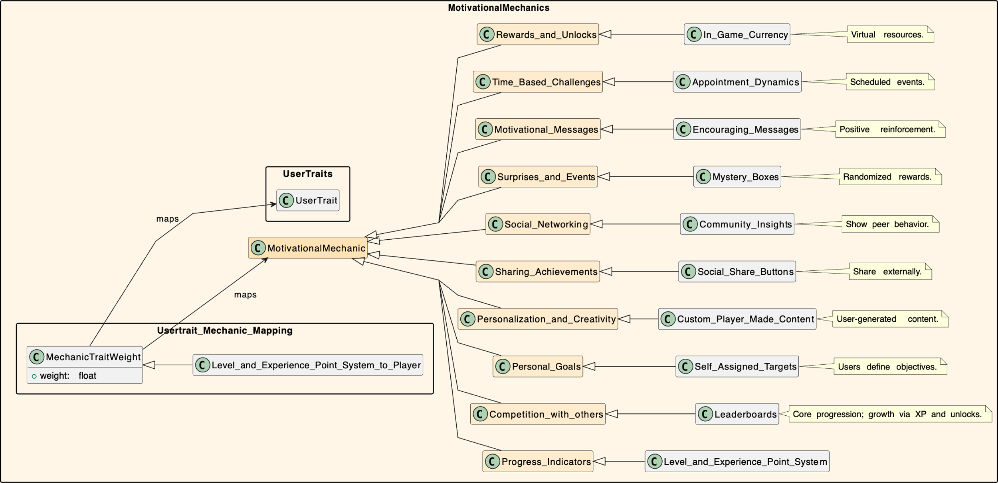
MotivationalMechanics (Catalog)
10 categories with one mechanic each as example
MechanicTraitWeight maps a mechanic to usertrait and gives it a weight

Slide 16
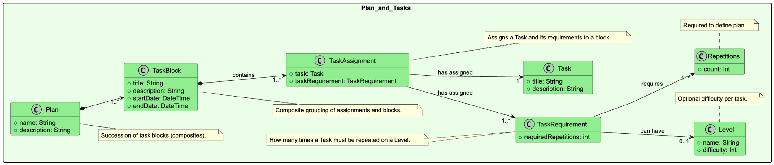
Plan and Tasks
Purpose: Defines progression timeline, difficulty curve, tasks and baseline goals for the user.
Serve as base for adherence calculation

Slide 17
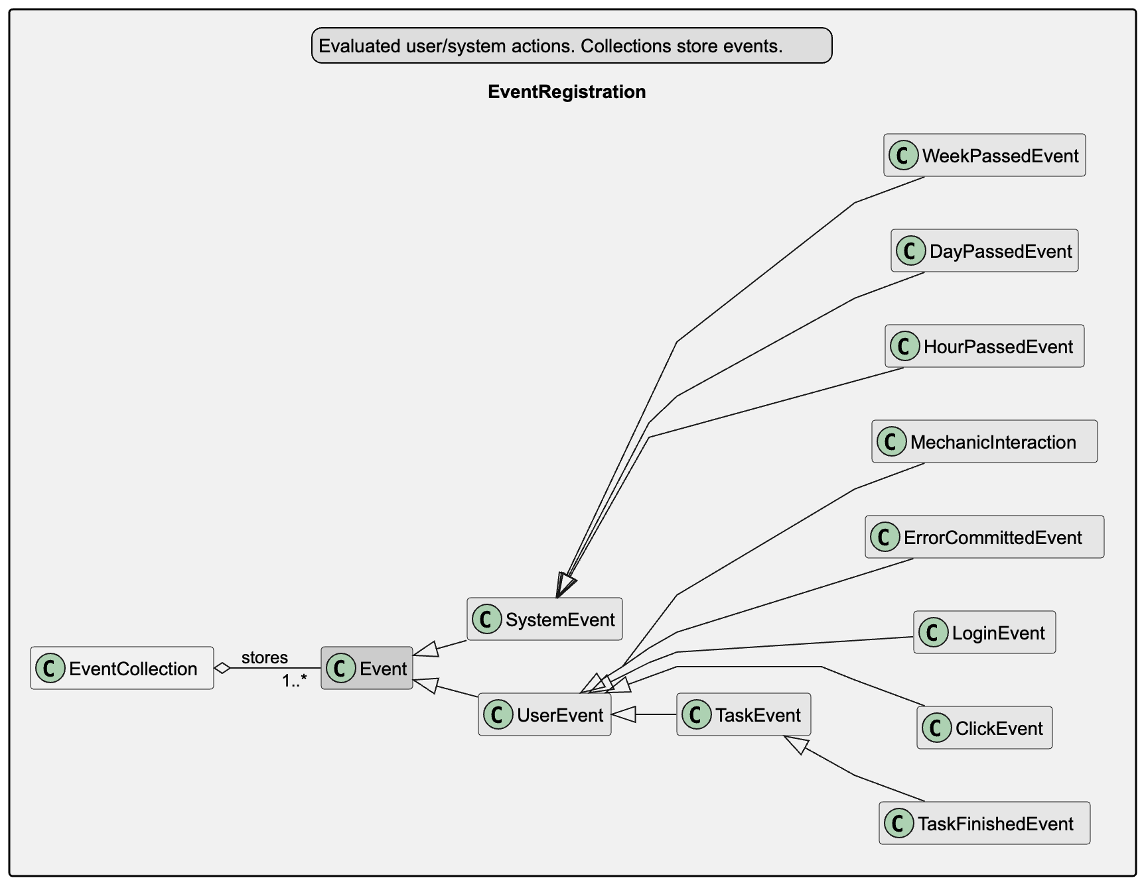
EventRegistration
Provides system events that happen without user action
User events when user interacts with application
Events are logged in event collection over time

Slide 18
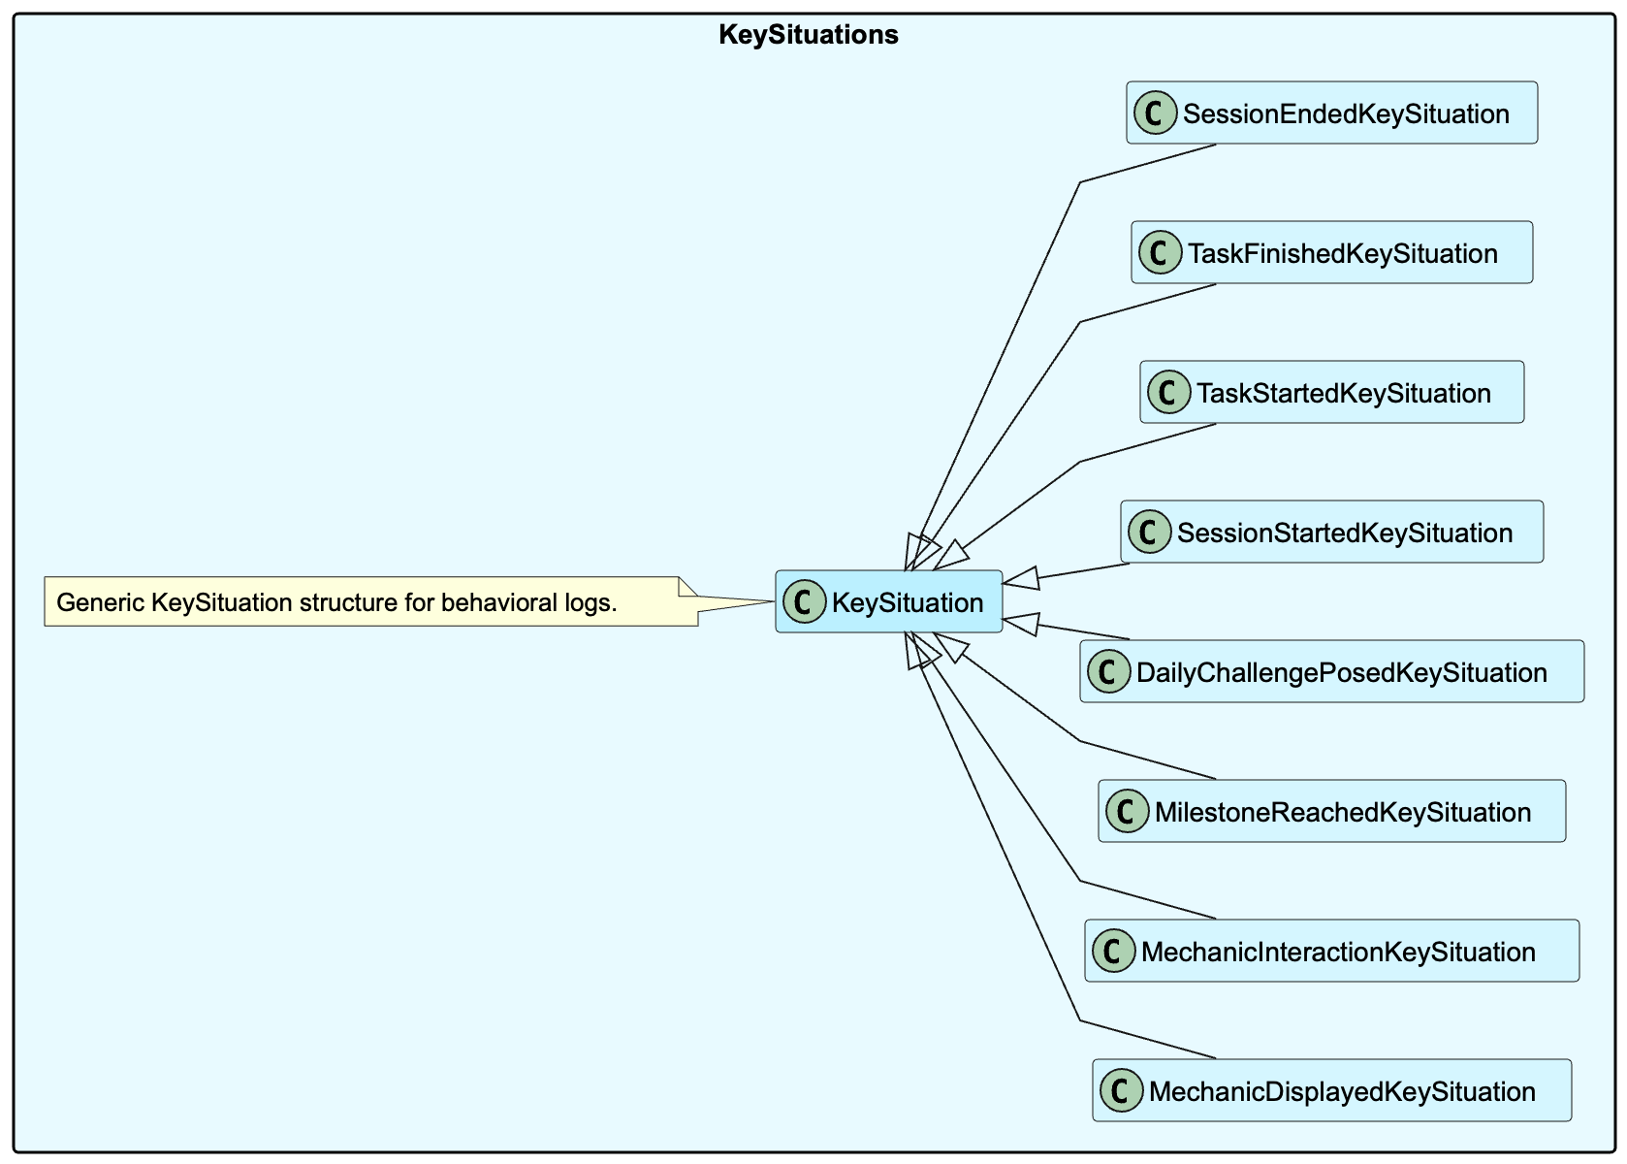
KeySituations
Are derived from events and define important moments like
-First login
-Session ended
Are composed or one or more events
For example: End of Session and end of first week

Slide 19
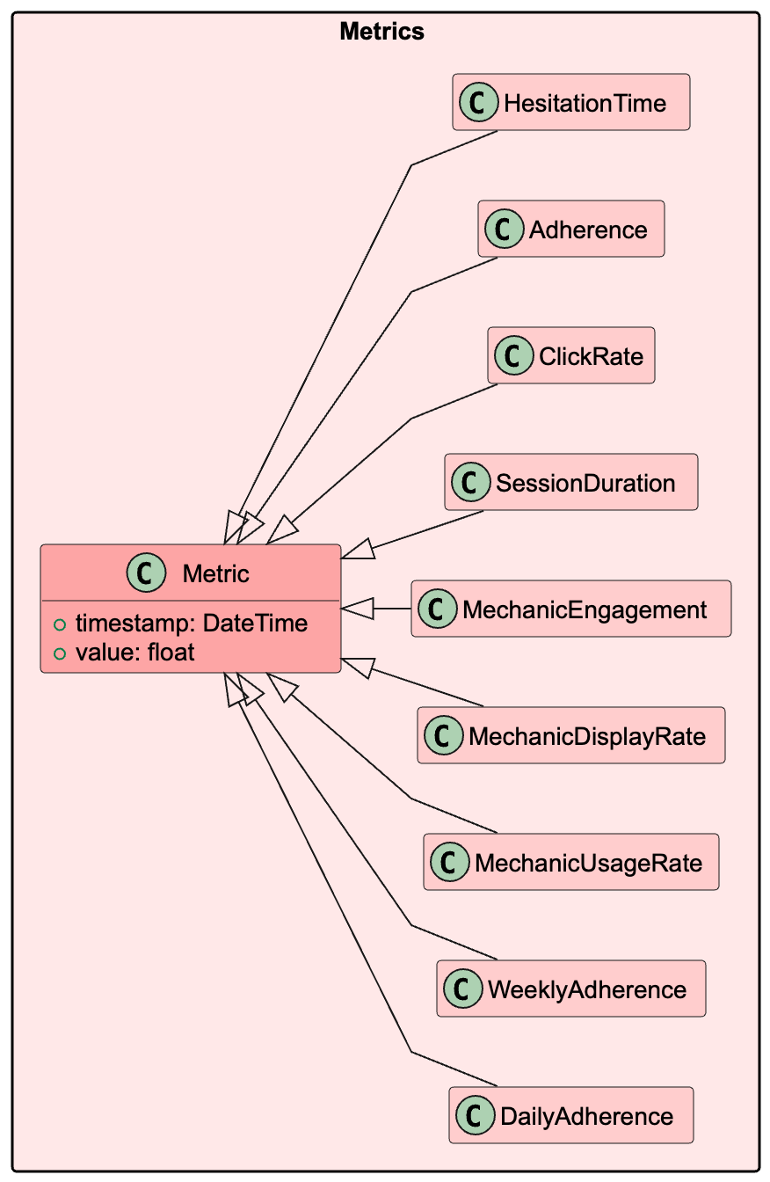
Metrics
Base class: Metric(timestamp, value)
Computed from event data using Goal–Question–Metric logic

Slide 20
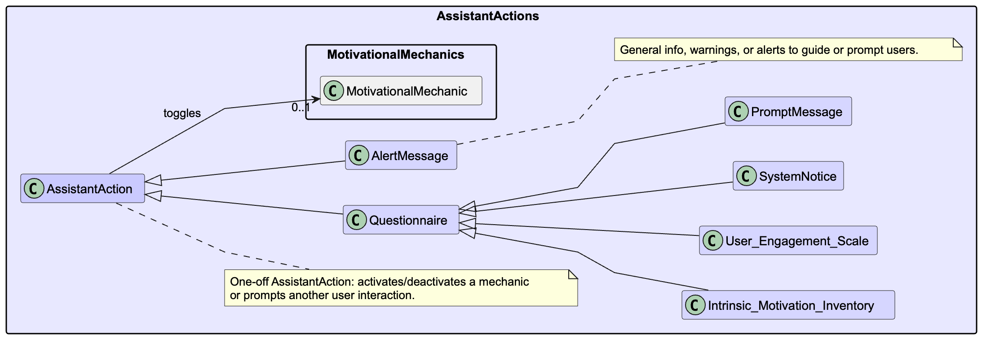
AssistantActions
An action targeting the user and prompting interaction
Can be a questionnaire, an alert message or turning on/off a motivational mechanic

Slide 21
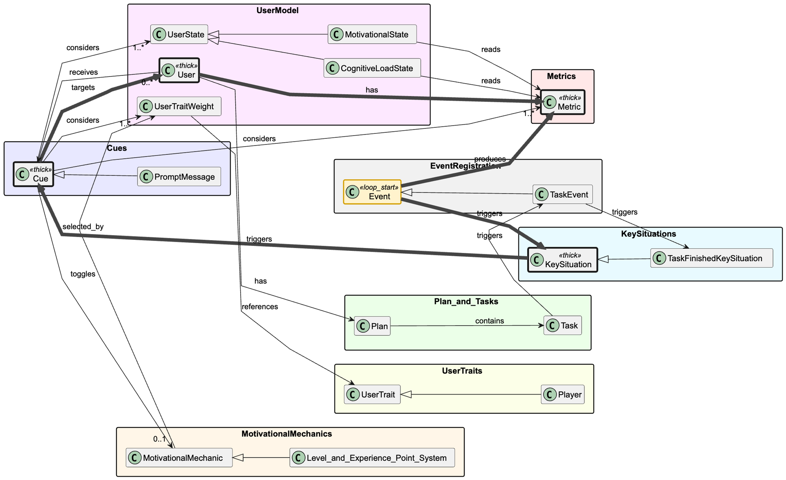
Relationships
Highlighted adaption pipeline

Slide 22
Decision and Monitoring Pipeline
Flow of Interaction and Adaptation
Overview: The system continuously monitors the user and reacts trigger relationships
Flow:
User performs actions → captured as Events
Events trigger KeySituations (e.g., task finished, challenge posed)
KeySituations update Metrics (adherence, engagement, usage rate)
Metrics inform decision logic to adapt Mechanics or Actions and Score and select MotivationalMechanics.
Deliver an Action (message/questionnaire/toggle) via the chosen mechanic
Learn by Updating engagement Merics (e.g., MechanicUsageRate). Smooth over time.
Outcome: A event driven feedback pipeline where user behavior drives metric updates, and metrics determine personalized motivational responses.

